Slide 1


^{COMPUTEROME 2.0}
^{USERS WORKSHOP}
CENTER FOR HEALTH DATA SCIENCE (HEADS)
FACULTY OF HEALTH AND MEDICAL SCIENCES,
UNIVERSITY OF COPENHAGEN, FEBRUARY, 2021

Slide 2
^{PART4}
^{A BRIEF PRACTICAL INTERMEZZ}

Slide 3


A BRIEF PRACTICAL INTERMEZZO
HOW DO YOU GET ACCESS OR HELP TO COMPUTEROME AT KU?
Get access via KU-IT’s selfservice at https://sd.ku.dk
If you need help, KU-IT can assist with a basic C2 training
More on C2 at KU on KUnet - employment guide and soon Research
KUnet
Computerome

Slide 4
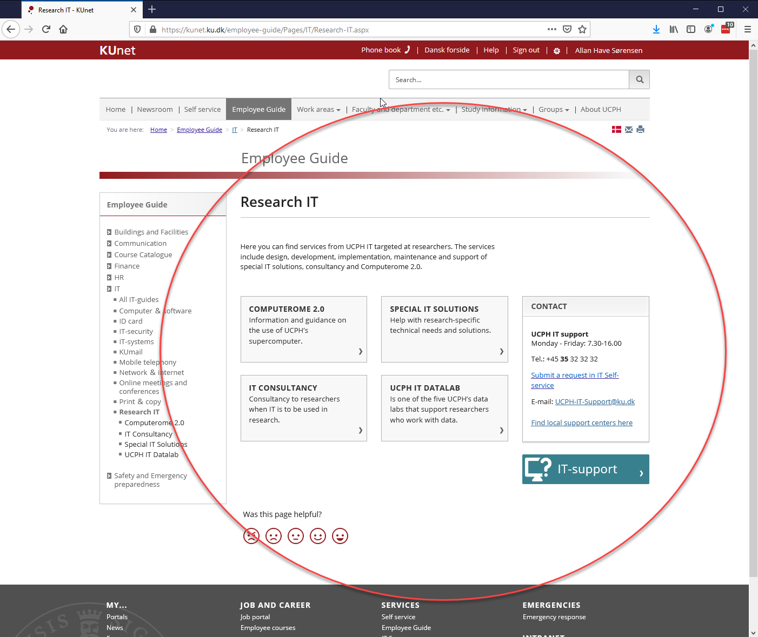
COMPUTEROME AT KUnet

Slide 5
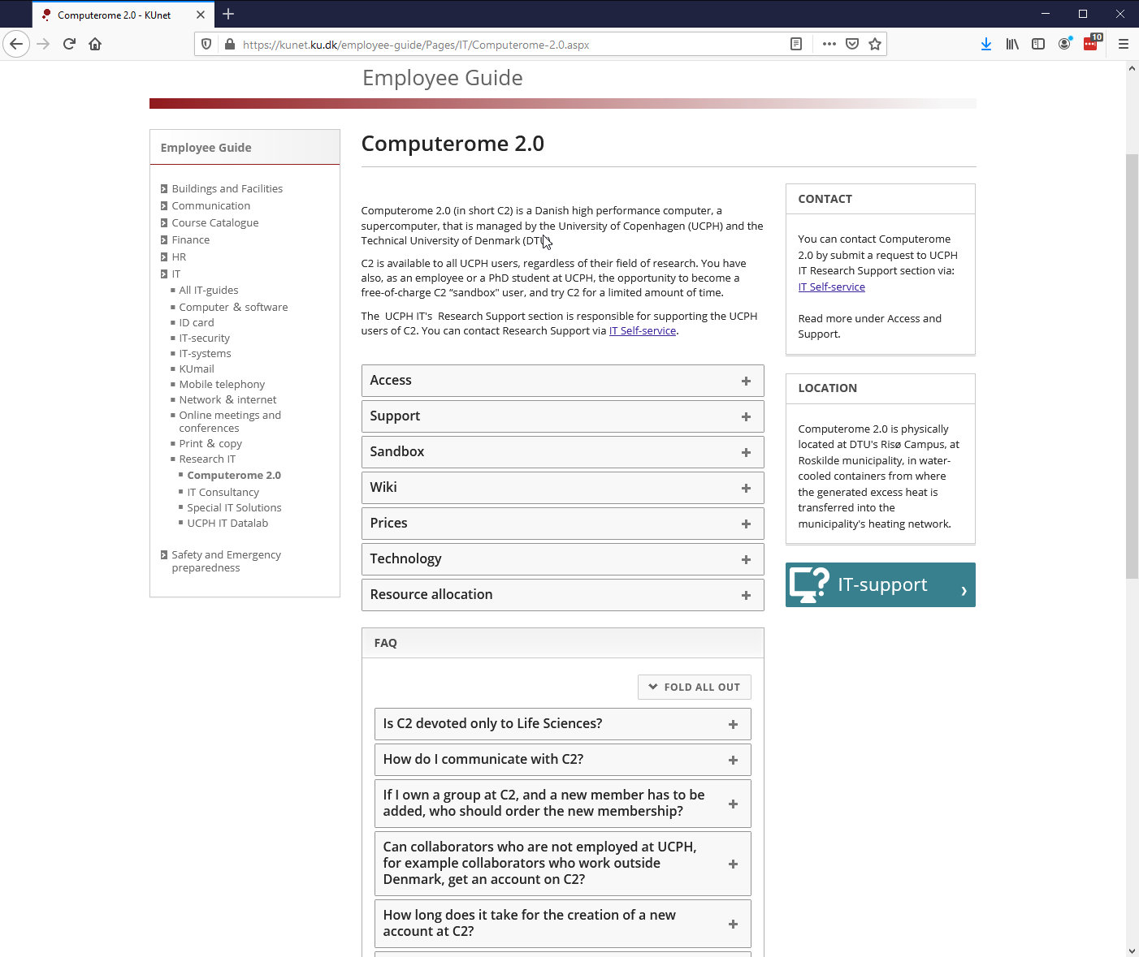
COMPUTEROME AT KUnet

Slide 6
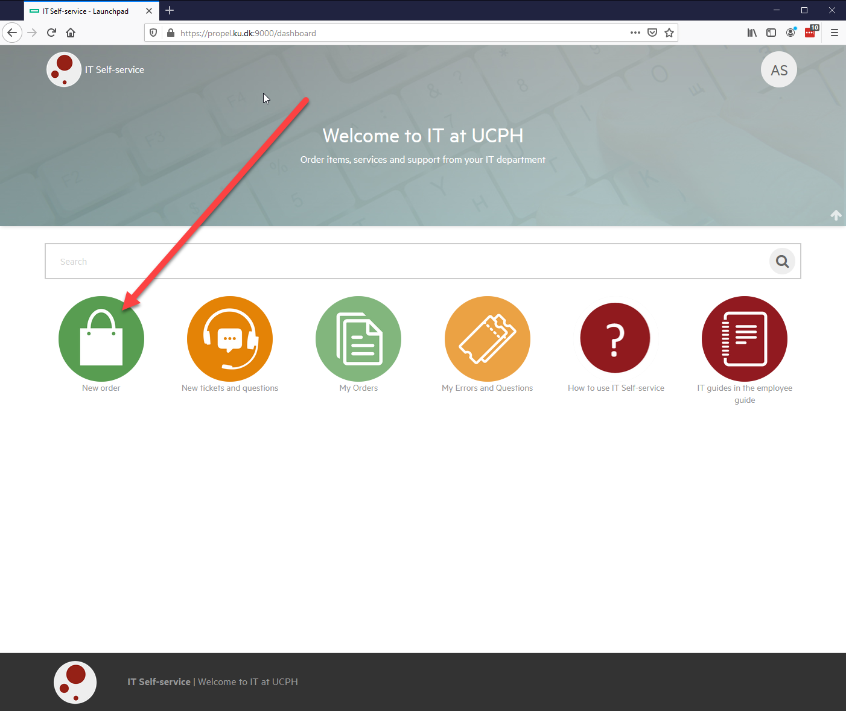
HOW TO CREATE A GROUP

Slide 7
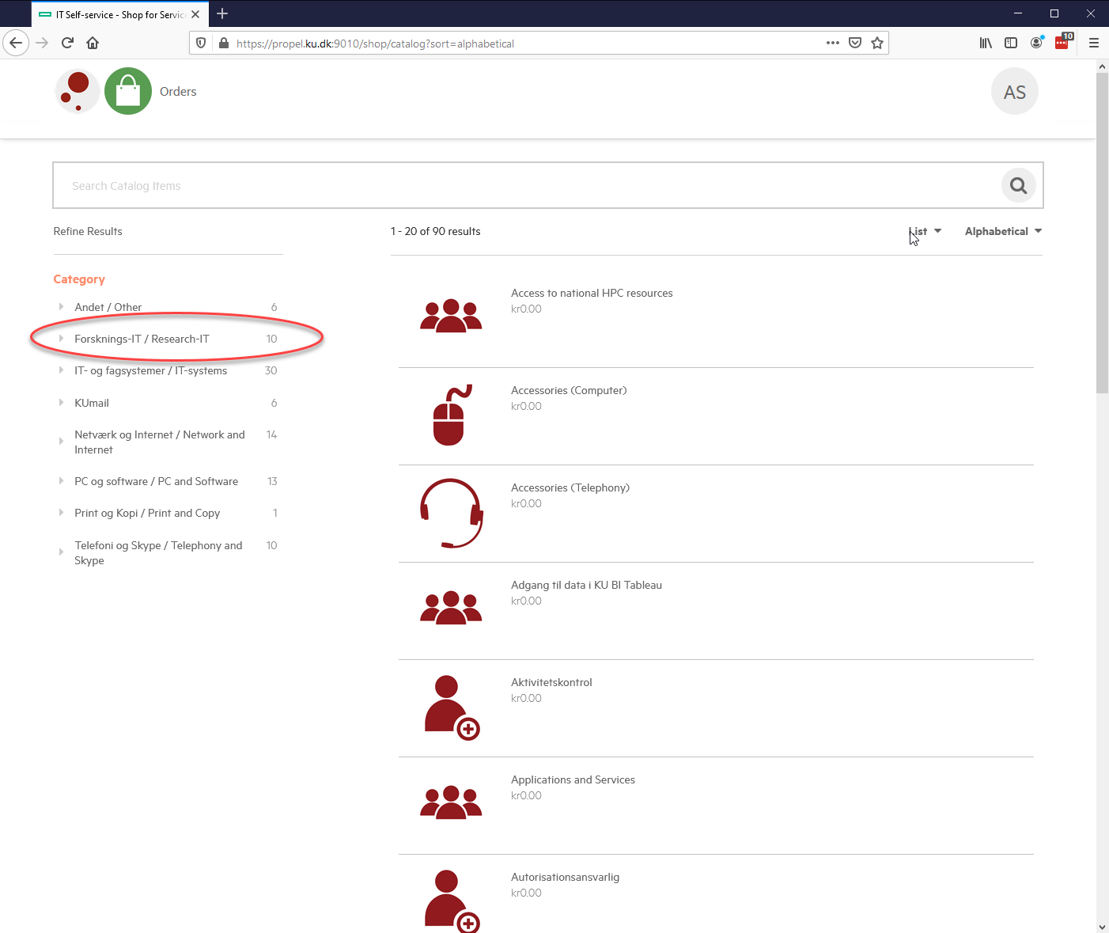
HOW TO CREATE A GROUP

Slide 8
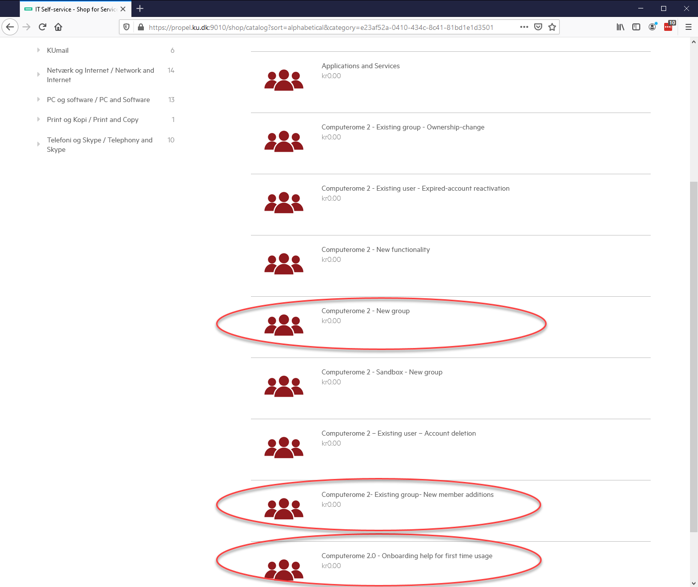
HOW TO CREATE A GROUP

Slide 9
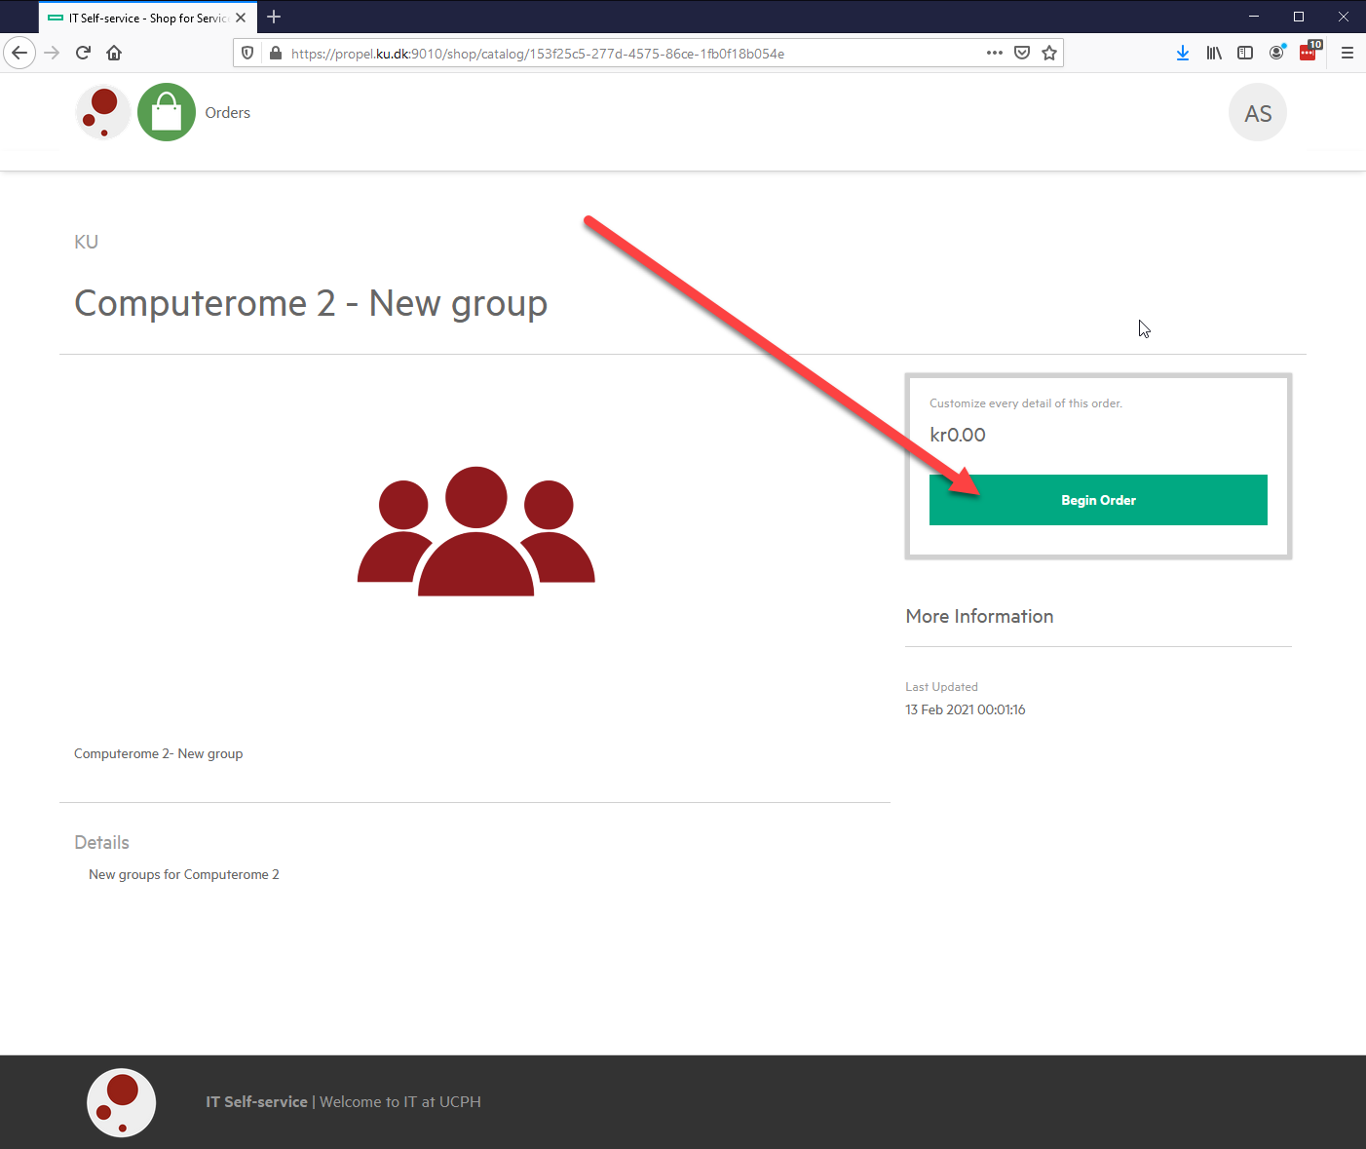
HOW TO CREATE A GROUP

Slide 10
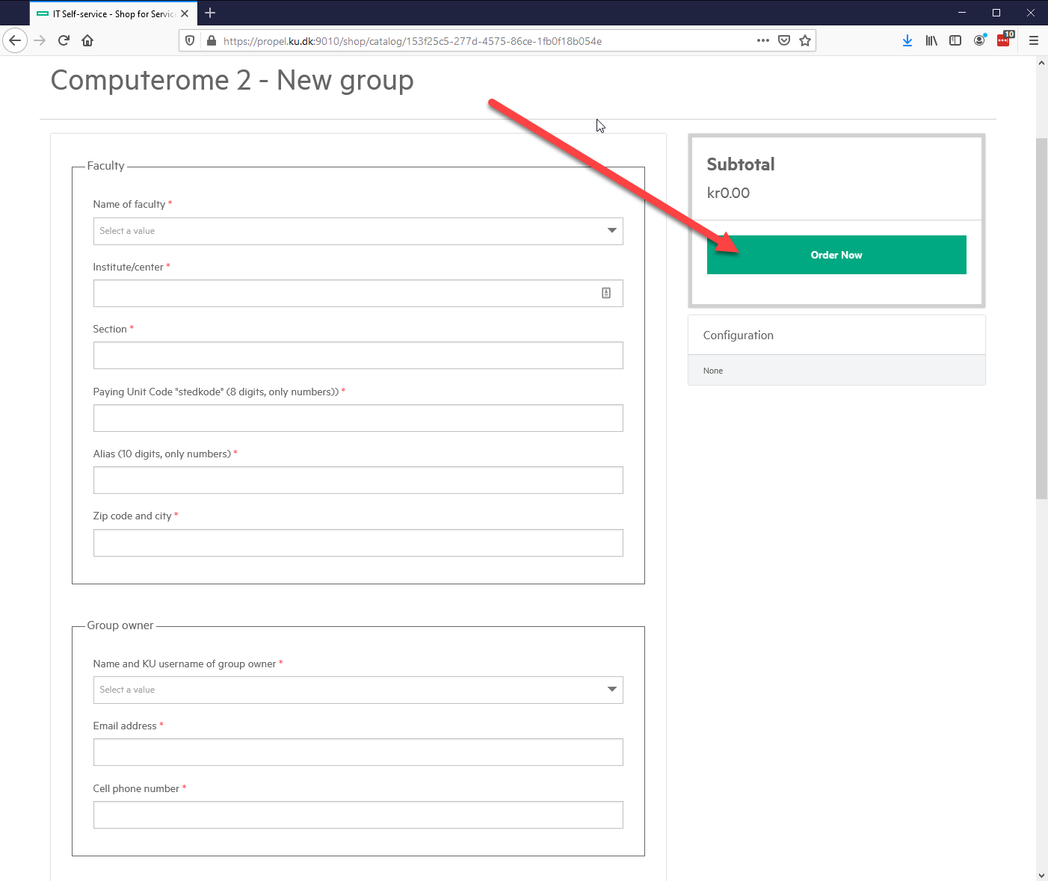
HOW TO CREATE A GROUP

